Slide 1
Lecture 11

Slide 2
Question 223.10.1
Light is a …
Electromagnetic Wave
Particle
Neither
Both

Slide 3
Question 223.10.2
The energy of a photon is proportional to
The wavelength
The period
The frequency
π

Slide 4
Question 223.10.3
The speed of light is always constant
True
False

Slide 5
Question 223.10.4
Can anything go faster than light?
Yes
No
maybe

Slide 6
The Nature of Light
Before the beginning of the nineteenth century, light was considered to be a stream of particles
The particles were either emitted by the object being viewed or emanated from the eyes of the viewer
Newton was the chief architect of the particle theory of light
He believed the particles left the object and stimulated the sense of sight upon entering the eyes

Slide 7
Nature of Light – Alternative View
Christian Huygens argued that light might be some sort of a wave motion

Slide 8
Huygens: Light is a wave
Smith: Light is important!
Maxwell:
Light is an
Electromagnetic
Wave
Einstein:
Light is a
limited EM wave
called a Photon
Young: Light is a wave
Newton: Light is a particle
1600
1700
Galileo: Doesn’t measure speed of light
1800
1900
2000
You:
Studied light
Romer: measures speed of light
B. Young: Moves us to Utah
Plank:
Light is a
quantized wave
Fizeau: Measures speed of light

Slide 9
Young’s Contribution
Thomas Young (1801) provided the first clear demonstration of the wave nature of light
He showed that light rays interfere with each other
Such behavior could not be explained by particles

Slide 10
Modern Scriptural Comments on Nature of Light
In September of 1832 Joseph Smith received a revelation that said in part :
For the word of the Lord is truth, and whatsoever is truth is light, and whatsoever is light is Spirit, even the Spirit of Jesus Christ. And the Spirit giveth light to every man that cometh into the world; and the Spirit enlighteneth every man through the world, that hearkeneth to the voice of the Spirit. (D&C 84:45-46)

Slide 11
Modern Scriptural Comments on Nature of Light
In December of 1832 Joseph Smith received another revelation that says in part:
This Comforter is the promise which I give unto you of eternal life, even the glory of the celestial kingdom; which glory is that of the church of the Firstborn, even of God, the holiest of all, through Jesus Christ his Son---He that ascended up on high, as also he descended below all things, in that he comprehended all things, that he might be in all and through all things, the light of truth; which truth shineth. This is the light of Christ. As also he is in the sun, and the light of the sun, and the power thereof by which it was made. As also he is in the moon, and is the light of the moon, and the power thereof by which it was made; as also the light of the stars, and the power thereof by which they were made; and the earth also, and the power thereof, even the earth upon which you astand. And the light which shineth, which giveth you light, is through him who enlighteneth your eyes, which is the same light that quickeneth your understandings; which light proceedeth forth from the presence of God to fill the immensity of space---the light which is in all things, which giveth life to all things, which is the law by which all things are governed, even the power of God who sitteth upon his throne, who is in the bosom of eternity, who is in the midst of all things. (D&C 88:5-12 emphasis added)

Slide 12
Huygens: Light is a wave
Smith: Light is important!
Maxwell:
Light is an
Electromagnetic
Wave
Einstein:
Light is a
limited EM wave
called a Photon
Young: Light is a wave
Newton: Light is a particle
1600
1700
Galileo: Doesn’t measure speed of light
1800
1900
2000
You:
Studied light
Romer: measures speed of light
B. Young: Moves us to Utah
Plank:
Light is a
quantized wave
Fizeau: Measures speed of light

Slide 13
More Confirmation of Wave Nature
During the nineteenth century, other developments led to the general acceptance of the wave theory of light
Maxwell asserted that light was a form of high-frequency electromagnetic wave
Hertz confirmed Maxwell’s predictions

Slide 14
Huygens: Light is a wave
Smith: Light is important!
Maxwell:
Light is an
Electromagnetic
Wave
Einstein:
Light is a
limited EM wave
called a Photon
Young: Light is a wave
Newton: Light is a particle
1600
1700
Galileo: Doesn’t measure speed of light
1800
1900
2000
You:
Studied light
Romer: measures speed of light
B. Young: Moves us to Utah
Plank:
Light is a
quantized wave
Fizeau: Measures speed of light

Slide 15
Particle Nature
Some experiments could not be explained by the wave nature of light
The photoelectric effect was a major phenomenon not explained by waves
When light strikes a metal surface, electrons are sometimes ejected from the surface
The kinetic energy of the ejected electron is independent of the frequency of the light

Slide 16
e
e
e
e
Big Battery

Slide 17
zzzzzzzzzzzzzzzzzzzzzzzz
Electron
Nucleus with protons and neutrons
Electron
Particles not drawn to scale

Slide 18
Outgoing Electron
Incoming photon

Slide 19
Particle Nature, cont.
Einstein (in 1905) proposed an explanation of the photoelectric effect that used the idea of quantization
The quantization model assumes that the energy of a light wave is present in particles called photons
E = hƒ
h is Planck’s Constant and = 6.63 x 10⁻³⁴ J.s

Slide 20
Dual Nature of Light
In view of these developments, light must be regarded as having a dual nature
Light exhibits the characteristics of a wave in some situations and the characteristics of a particle in other situations
Nature prevents testing both qualities at the same time

Slide 21
Huygens: Light is a wave
Smith: Light is important!
Maxwell:
Light is an
Electromagnetic
Wave
Einstein:
Light is a
limited EM wave
called a Photon
Young: Light is a wave
Newton: Light is a particle
1600
1700
Galileo: Doesn’t measure speed of light
1800
1900
2000
You:
Studied light
Romer: measures speed of light
B. Young: Moves us to Utah
Plank:
Light is a
quantized wave
Fizeau: Measures speed of light

Slide 22
Measurement of the Speed of Light

Slide 23
Measurements of the Speed of Light
Since light travels at a very high speed, early attempts to measure its speed were unsuccessful
Remember c = 3.00 x 10⁸ m/s
Galileo tried by using two observers separated by about 10 km
The reaction time of the observers was more than the transit time of the light

Slide 24
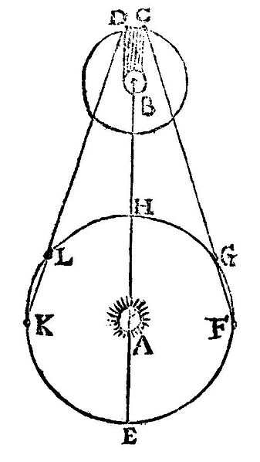
Measurement of the Speed of Light – Roemer’s Method
Ole Roemer (1675) used astronomical observations to estimate the speed of light
He used the period of revolution of Io, a moon of Jupiter, as Jupiter revolved around the sun

Slide 25
Roemer’s Method, cont.
The periods of revolution were longer when the Earth was receding from Jupiter
and shorter when the Earth was approaching
Using Roemer’s data, Huygens estimated the lower limit of the speed of light to be 2.3 x 10⁸ m/s
This was important because it demonstrated that light has a finite speed as well as giving an estimate of that speed

Slide 26
Measurements of the Speed of Light – Fizeau’s Method
This was the first successful method for measuring the speed of light by means of a purely terrestrial technique
It was developed in 1849 by Armand Fizeau
He used a rotating toothed wheel
The distance between the wheel (considered to be the source) and a mirror was known

Slide 27
Huygens: Light is a wave
Smith: Light is important!
Maxwell:
Light is an
Electromagnetic
Wave
Einstein:
Light is a
limited EM wave
called a Photon
Young: Light is a wave
Newton: Light is a particle
1600
1700
Galileo: Doesn’t measure speed of light
1800
1900
2000
You:
Studied light
Romer: measures speed of light
B. Young: Moves us to Utah
Plank:
Light is a
quantized wave
Fizeau: Measures speed of light

Slide 28
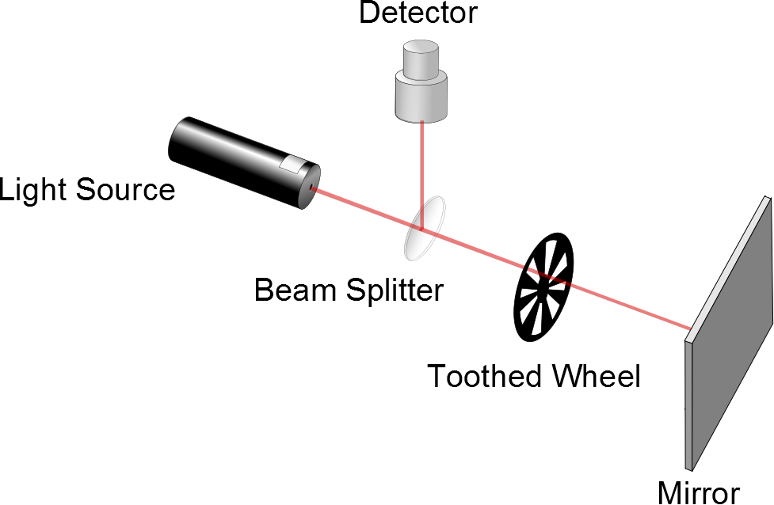
Fizeau’s Method, cont.
d is the distance between the wheel and the mirror
Δt is the time for one round trip
Then c = 2d / Δ t
Fizeau found a value of
c = 3.1 x 10⁸ m/s

Slide 29
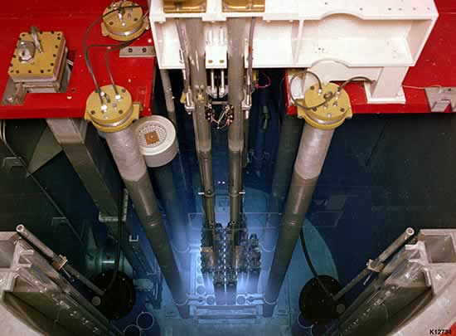
Faster than light?

Slide 30
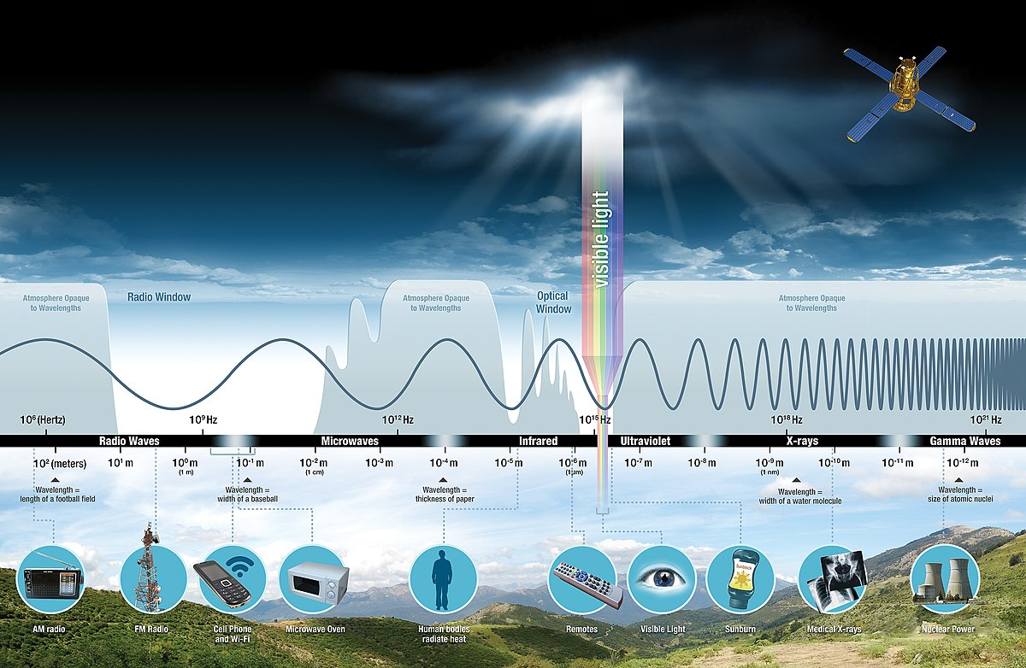

Slide 31
Question 223.13.4
I have a ray of light traveling from left to right across the room near the front. Can you see the ray?
No
Yes
I can see only part of the ray

Slide 32
Question 223.13.5
A laser beam is incident on a glass sheet. There is no apparent reflected ray. We might conclude that…
The glass has a high index of refraction
The glass surface is rough
The glass has a low index of refraction
The glass is opaque

Slide 33
Wave Crests
Rays

Slide 34
Question 9.1
A specular reflector is ……..
A reflector that is spectacular!
One that can cook a hot dog
Like a mirror
A rough surface

Slide 35
Rays

Slide 37
Question 35.3.6
I have a neat demo on the board where light goes from left to right. You can see the path the light takes. How can this be?
The light ray is a different color than the laser, so I can see it.
The light ray must follow the law of reflection, so it must be bouncing back along it’s original path
The light ray must be hitting dust in the air as it travels, so we see the scattered light from the dust.
The light is not a single ray, and part of the light beam it hits the board, sending rays to my eyes

Slide 39
θ_{i}
θ_{r}

Slide 40
Question 9.2
A diffuse reflector is ……..
A reflector that is spectacular!
One that can cook a hot dog
Like a mirror
A rough surface

Slide 41
Question 223.13.6
Are most natural surfaces diffuse or specular reflectors?
Diffuse
Specular

Slide 42
Question 223.13.7
mirror
An observer at point O is facing a mirror and observes a light source S. Where does the observer perceive the mirror image of the source to be located?
O
3
1
S
2
4

Slide 43
Question 223.13.8
In the movies, you sometimes see an actor looking in a mirror and you can see his face in the mirror. During the filming of this scene, what does the actor see in the mirror?
his face
your face
the director’s face
the movie camera
impossible to determine

Slide 44
Question 223.13.9
When watching the Moon over the ocean, you often see a long streak of light on the surface of the water. This occurs because:
the Moon is very large
atmospheric conditions are just right
the ocean is calm
the ocean is wavy
motion of the Moon
G

Slide 45
Law of Reflection, cont.
The angle of reflection is equal to the angle of incidence
θ₁’= θ₁
This relationship is called the Law of Reflection
The incident ray, the reflected ray and the normal are all in the same plane

Slide 46
Retroreflection
Assume the angle between two mirrors is 90º
The reflected beam returns to the source parallel to its original path
This phenomenon is called retroreflection
θ₄
θ₃
θ₁
β
θ₂
α

Slide 47
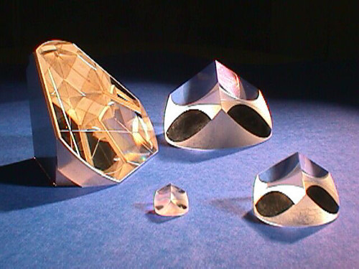
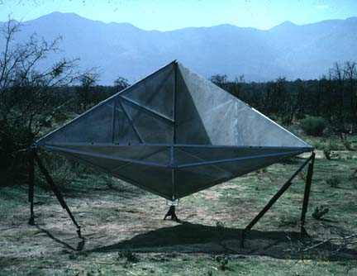
Retroreflectors

Slide 48
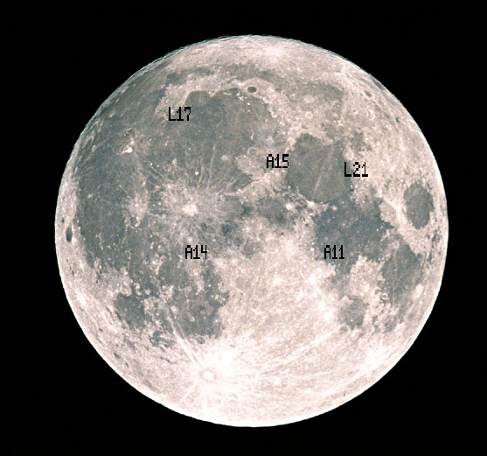
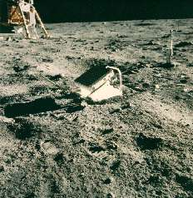
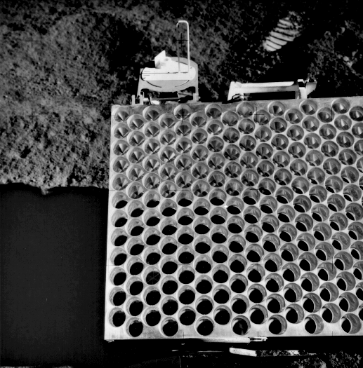
Apollo Retro-reflectors

Slide 49
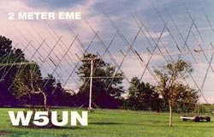
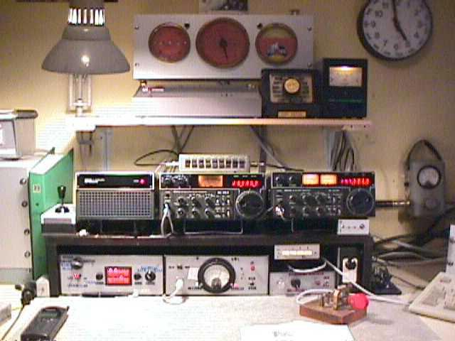
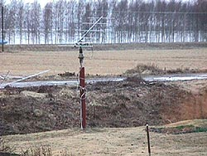
Try it at Home
Amateur Radio Moonbounce Communication
http://www.arrl.org/news/features/2002/01/21/1/

Slide 50
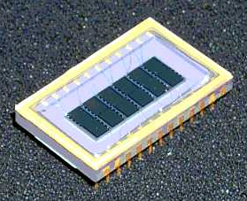
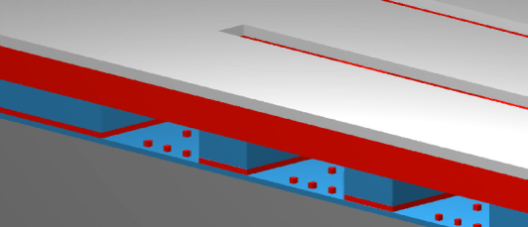
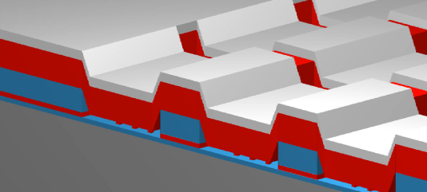
Micro Mirror Arrays
A high-tech example is the new micro-mirror arrays
ITT version
Metal “Mirror”
+-
GEMS Device Off-State
GEMS Device On-State
6 channel GEMS Device
(50 Channel Device is in Development)

Slide 51
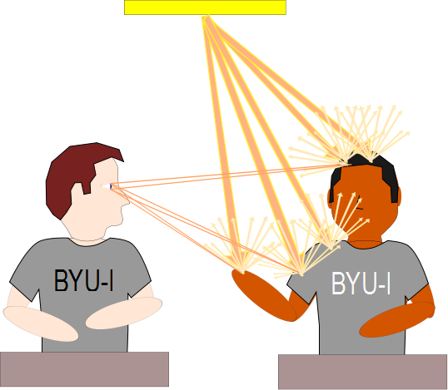

Slide 52
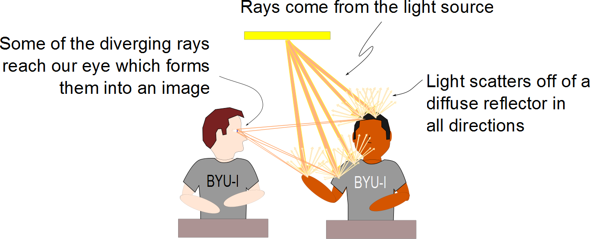

Slide 53
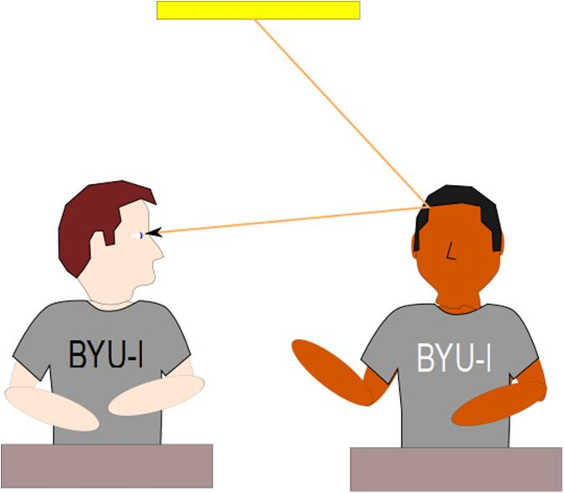
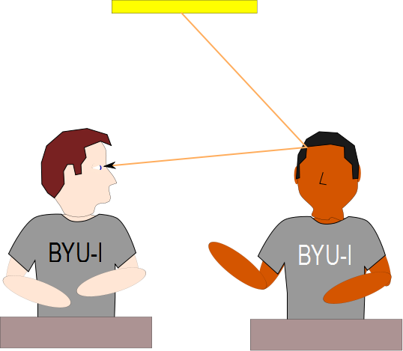

Slide 54
Question 223.13.10
You hold a hand mirror 0.5 m in front of you and look at your reflection in a full-length mirror 1 m behind you. How far in back of the big mirror do you see the image of your face?
0.5 m
1.0 m
1.5 m
2.0 m
2.5 m
G

Slide 55
END

Slide 56
Question
Screen
I now have three “slits” with light going through them. What will I see on the screen?
Just a blur of light
Still bright spots and dark spots
Nothing, most of the light doesn’t get through
Exactly three bright spots

Slide 57
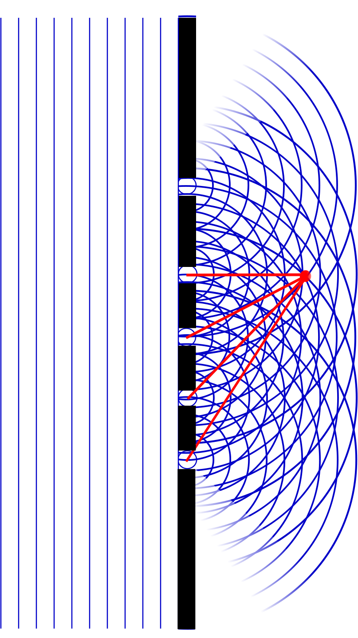

Slide 58
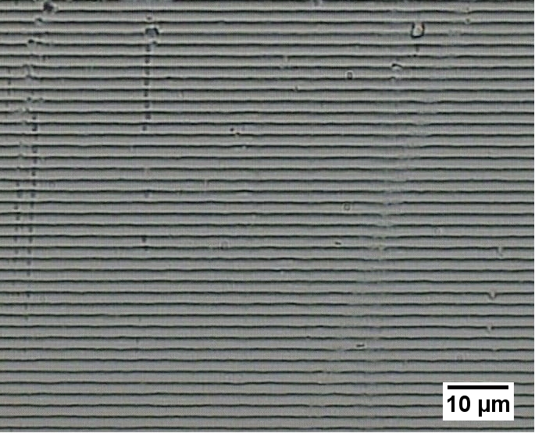

Slide 59
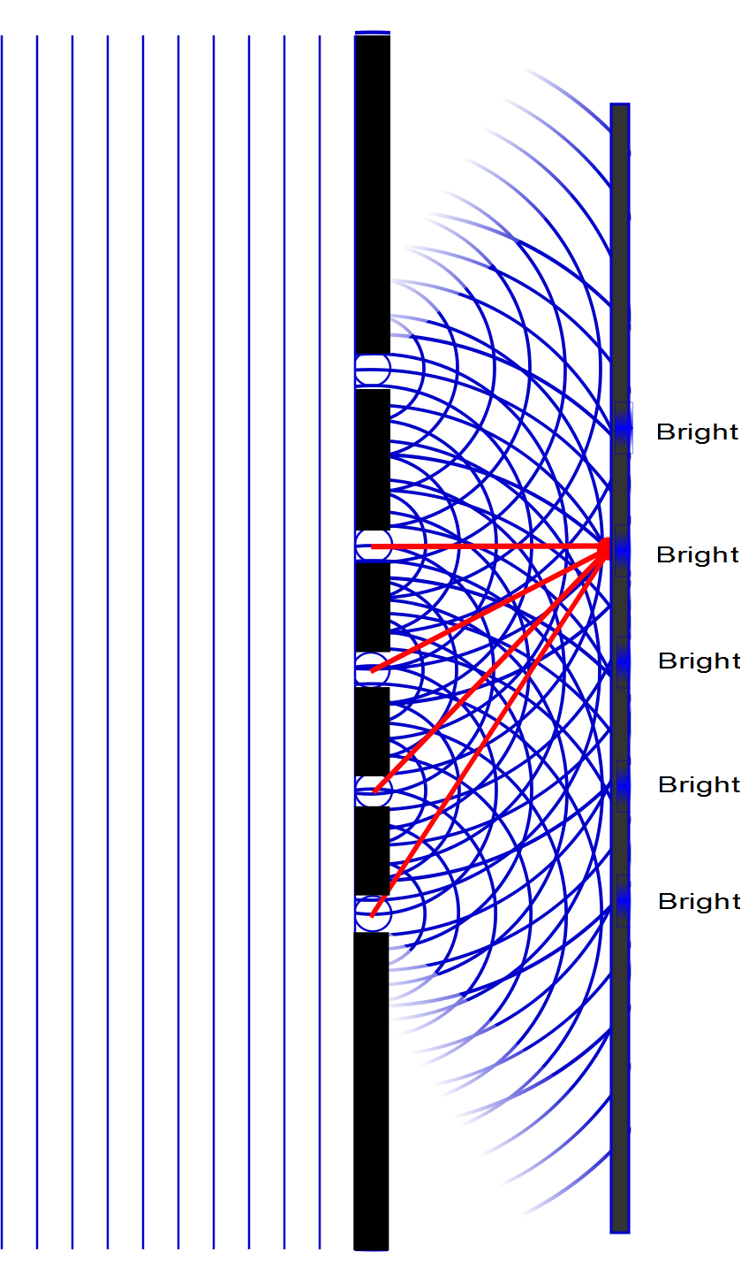

Slide 60
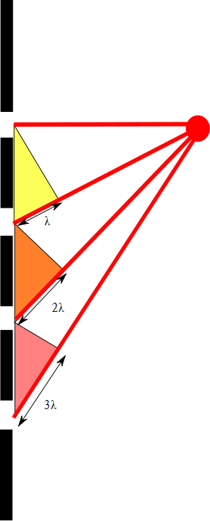

Slide 61
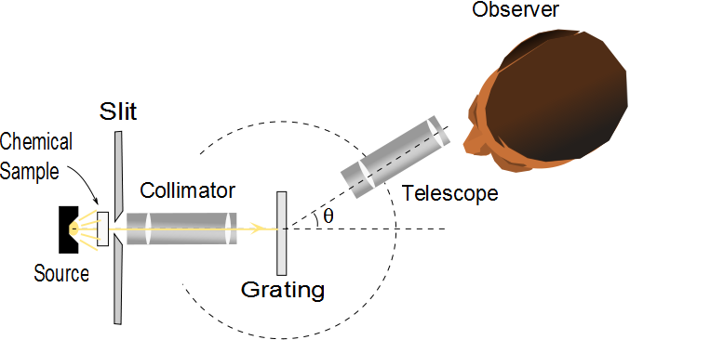
Diffraction Grating Spectrometer
The collimated beam is incident on the grating
The diffracted light leaves the gratings and the telescope is used to view the image
The wavelength can be determined by measuring the precise angles at which the images of the slit appear for the various orders

Slide 62
Details

Slide 63
Diffraction Grating, Intensity, cont.
Characteristics of the intensity pattern
The sharp peaks are in contrast to the broad, bright fringes characteristic of the two-slit interference pattern
Because the principle maxima are so sharp, they are much brighter than two-slit interference patterns

Slide 64
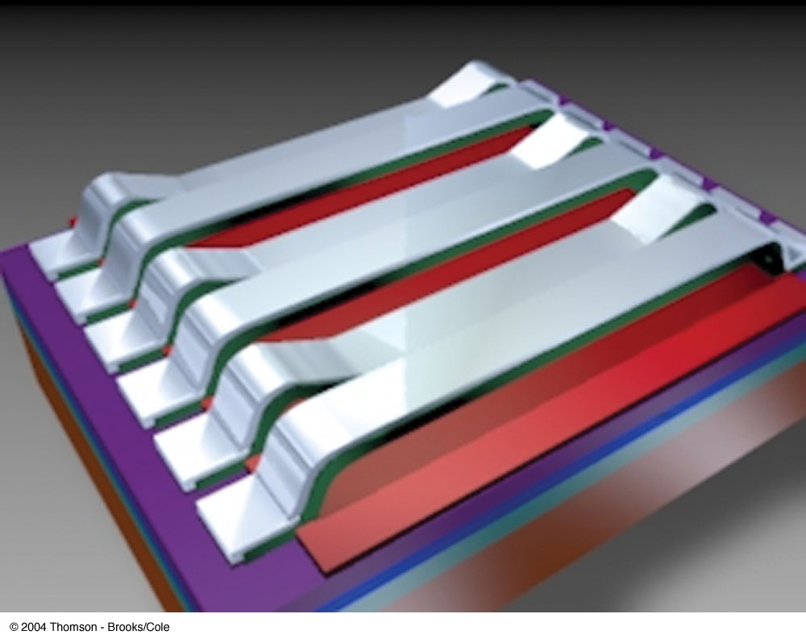
Grating Light Valve
A grating light valve consists of a silicon microchip fitted with an array of parallel silicon nitride ribbons coated with a thin layer of aluminum
When a voltage is applied between a ribbon and the electrode on the silicon substrate, an electric force pulls the ribbon down
The array of ribbons acts as a diffraction grating

Slide 65
Resolving Power of a Diffraction Grating
For two nearly equal wavelengths, λ₁ and λ₂, between which a diffraction grating can just barely distinguish, the resolving power, R, of the grating is defined as
Therefore, a grating with a high resolution can distinguish between small differences in wavelength

Slide 66
Single Slit Envelope
2 slits
Intensity pattern
3 slits
4 slits
5 slits
10 slits
100 slits

Slide 67
Resolving Power of a Diffraction Grating, cont
The resolving power in the mth-order diffraction is R = Nm
N is the number of slits
m is the order number
Resolving power increases with increasing order number and with increasing number of illuminated slits

Slide 68
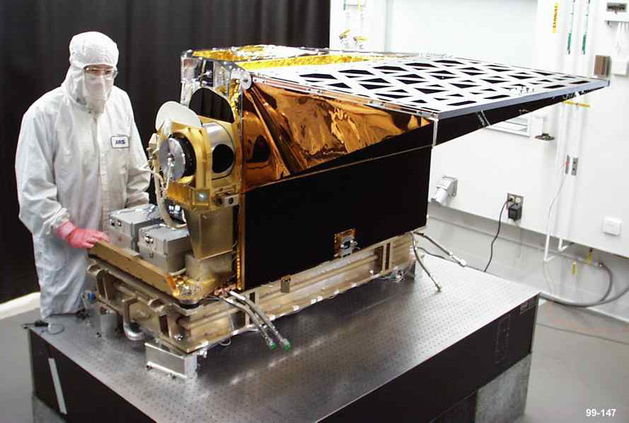
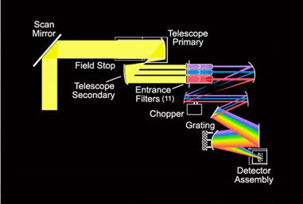
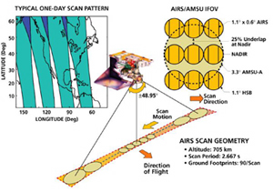
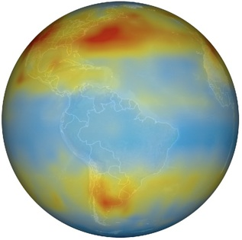
AIRS

Slide 69
Question 223.11.0.1
1
We now have just one slit.
What is the path difference between ray 1 and ray 2?
a)
b)
c)
d)
2
3
a/2
θ
a

Slide 70
Question 223.11.1
Suppose you have a single slit diffraction pattern. If you increase the size of the slit, the size of the central maximum
Becomes wider
Becomes narrower
Stays the same
Fades to non-existent
a
θ
L

Slide 71
Question 223.12.1
I have a single slit illuminated by a laser. The slit width is a and the light that passes through the slit lands on the screen, a distance L away. If the screen is moved farther away, the size of the central spot will
Increase
Decrease
Stay the same
Impossible to tell

Slide 72
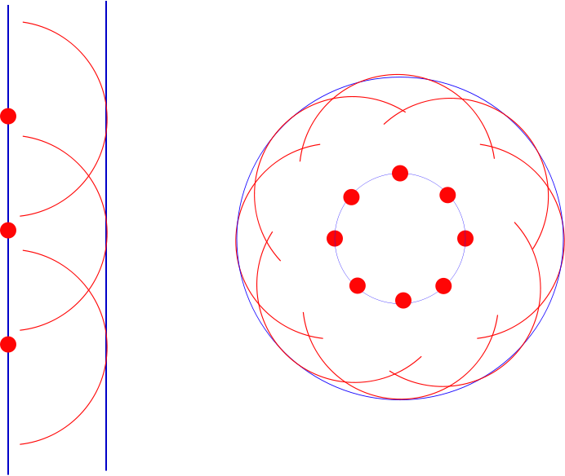

Slide 73
Single-Slit Diffraction
a/2
θ
a

Slide 74
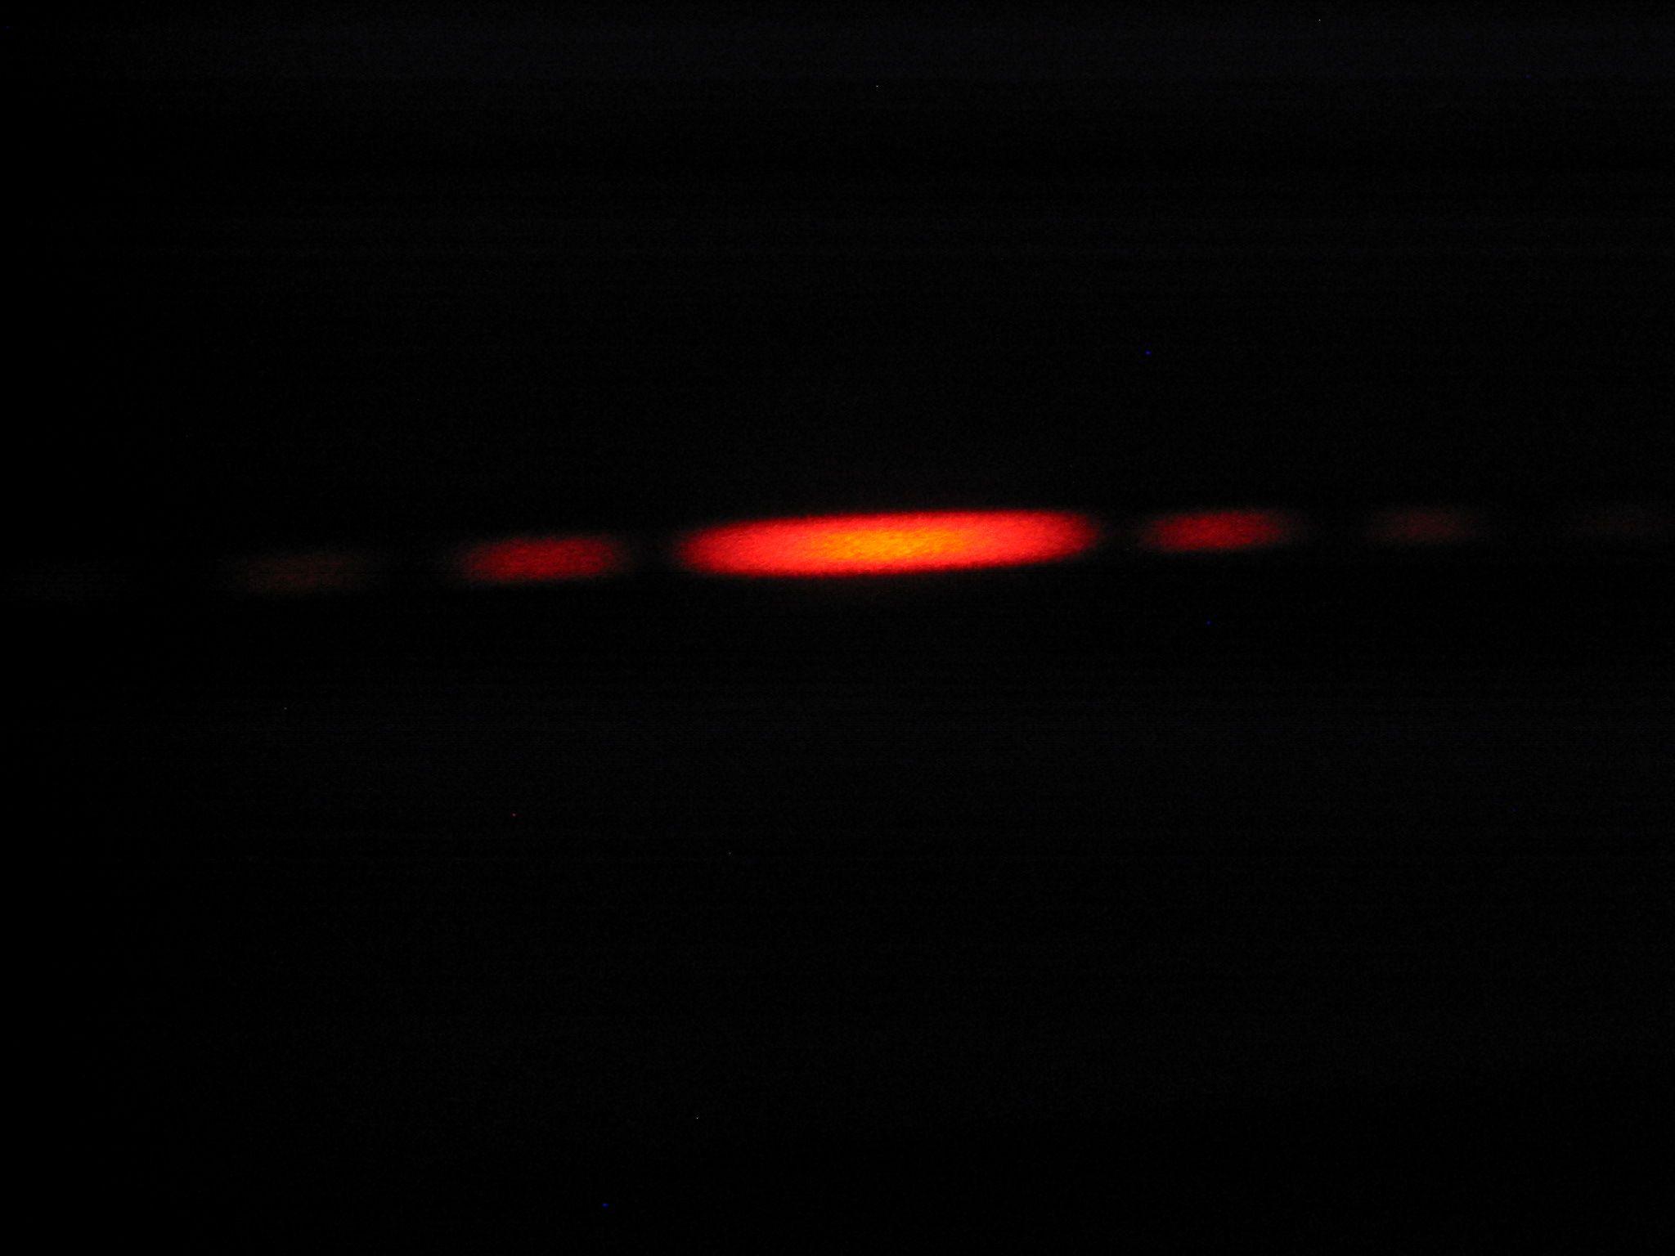
Diffraction Pattern, Single Slit
The diffraction pattern consists of the central maximum and a series of secondary maxima and minima
The pattern is similar to an interference pattern

Slide 75
Fraunhofer Diffraction Pattern
A Fraunhofer diffraction pattern occurs when the rays leave the diffracting object in parallel directions
Screen very far from the slit
Could be accomplished by a converging lens
a
θ
L

Slide 76
Diffraction vs. Diffraction Pattern
Diffraction refers to the general behavior of waves spreading out as they pass through a slit
A diffraction pattern is actually a misnomer that is deeply entrenched
The pattern seen on the screen is actually another interference pattern
The interference is between parts of the incident light illuminating different regions of the slit

Slide 77
Single-Slit Diffraction
5
4
3
2
1
a/2
a
θ

Slide 78
Single-Slit Diffraction
a/6
a
θ

Slide 79
Single-Slit Diffraction, 2
The resultant light intensity on a viewing screen depends on the direction θ
The diffraction pattern is actually an interference pattern
The different sources of light are different portions of the single slit

Slide 80
Single-Slit Diffraction, Analysis
All the waves that originate at the slit are in phase
Wave 1 travels farther than wave 3 by an amount equal to the path difference
(a/2) sin θ
If this path difference is exactly half of a wavelength, the two waves cancel each other and destructive interference results
In general, destructive interference occurs for a single slit of width a when sin θ_{dark} = mλ / a
m = ±1, ±2, ±3, …

Slide 81
Diffraction from Narrow Slits

Slide 82
Single-Slit Diffraction, Intensity
The general features of the intensity distribution are shown
A broad central bright fringe is flanked by much weaker bright fringes alternating with dark fringes
Each bright fringe peak lies approximately halfway between the dark fringes
The central bright maximum is twice as wide as the secondary maxima
a
θ
L

Slide 83
Intensity
The intensity can also be expressed as
Minima occur at

Slide 84
sinc(x)

Slide 85
(sinc(x))²

Slide 86

I
Interference fringes:
due to having a single slit
-2π
-π
π
2π
φ/2

Slide 87
Intensity of Two-Slit Diffraction Patterns
When more than one slit is present, consideration must be made of
The diffraction patterns due to individual slits
The interference due to the wave coming from different slits
The single-slit diffraction pattern will act as an “envelope” for a two-slit interference pattern

Slide 88
Intensity Equation
To determine the maximum intensity:
The factor in the square brackets represents the single-slit diffraction pattern
This acts as the envelope
The two-slit interference term is the cos² term

Slide 89
Missing Maxima
To find which interference maximum coincides with the first diffraction minimum
The conditions for the first interference maximum
d sin θ = mλ
The conditions for the first diffraction minimum
a sin θ = λ

Slide 90
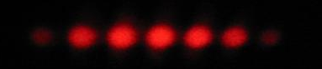
I
Interference fringes:
due to having two slits.
φ/2
-5π
-3π
-π
π
3π
5π

Slide 91
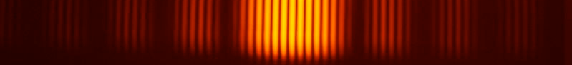
Diffraction envelope:
The single slit pattern due to shape of the individual slits.
I
Interference fringes:
due to having two slits.
φ/2
-3π
-2π
-π
π
2π
3π

Slide 92
First Minimum
Circular Aperture
θ
D
w
Central Maximum
Intensity Pattern
L

